Slide 1

Ortho Eyes
Tim bekema
Beau fiechter
Donna van grunsven
Jasmijn Heupers
Emma korf
Danny vink

Slide 2
Table of contents
Recap
What did we do?
What will we do next?
Questions

Slide 3
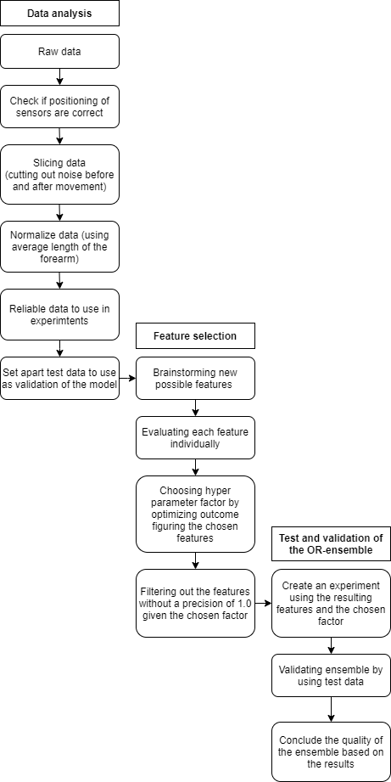
Recap
The research question
Which models can be added to the OR-ensemble to improve the classification of individuals to the correct patient group using the existing data from a Flock of Birds system?

Slide 4
What did we do?
Feature selection
Irrelevant features
Features that measure protocol instead of shoulder injury
Researched and used other ensemble methods
Decision tree
AdaBoost
Bagging
Will apply our dataset on these methods when the features selection is finished
Writing the paper
Other ensemble methods
Medically justify the chosen features
Future research

Slide 5
What will we do next?
Compare other ensemble methods to our OR-ensemble
Continue writing the paper
Test our OR-ensemble on the test data

Slide 6
Questions?

